Slide 1
The SelectAutoXpert program:
a powerful growth solution for the Automotive Service Provider

Slide 2
Who We Are
Company name
Mr. XXXXX XXXXX (Title)
Founded in XXXX
XX employees
XX experienced clerks
XX Branches
XXXXX
XXXXX
$X in inventory
X delivery vehicles

Slide 3
Products
Over 2 million top-quality premium brand products for vehicles and replacement related parts sourced from recognized suppliers.
A Product & Market Development team that provides the Uni-Select Network with product strategies to answer the needs of the marketplace.

Slide 4
Key Product Categories
National Brands
Parts For Import Nameplates
Temperature Control
Tools & Equipment
Paint, Body & Equipment
Private Brands: Auto Extra, World Parts, Mäktig, PureZone and more

Slide 5
The Uni-Select Network
Canada’s leader in the distribution of automotive parts, tools and equipment to the aftermarket
10 distribution centres across Canada
Growing network of corporate store across Canada
More than 525 jobber members and over 1,100 stores in Canada
$1.1 billion (USD) in sales.

Slide 6
Tools and solutions to support your business growth!
Rebates
Warranties
Technology and Diagnostics
Preventive maintenance
Training and Coaching
Additional Advantages
Don’t forget that you can always count on your dedicated Uni-Select National Business Solutions team!
Notes:
SAX supprimer signage et branding

Slide 7
Program Positioning

Slide 8
Fees: $35.00
Sign-up fee: $395.00
Member fee: None
Welcome kit value: $ 50.00
+ 1 month of TechPro Online for free
Legend
À la carte (may be charged additional fees)
Included in your monthly fee

Slide 9
Rebates

Slide 10
Loyalty Rebates
Purchase products from participating suppliers via your Uni-Select member and get USI DOLLARS
Calculation Chart for Eligible Lines* Percentage of rebate transferable in USI Dollars
Annual Purchases $** | Regular Lines | Specialty Lines
$30,000 to $59,999 | 2 % | 0.33 %
$60,000 to $99,999 | 3 % | 0.66 %
$100,000 to $149,999 | 4 % | 1 %
$150,000 to $199,999 | 5 % | 1.33 %
$200,000 to $249,999 | 5.5 % | 1.33 %
$250,000 to $299,999 | 6 % | 1.33 %
$300,000 to $349,999 | 6.5 % | 1.33 %
$350,000 and up | 7 % | 1.33 %
*See chart for eligible lines. ** Only includes purchases made from participating manufacturers.

Slide 11
Warranties

Slide 12
INCREASE OF THE LABOUR REINBURSEMENT RATES
Door Rates (as of 2015)
$65 Atlantic/Quebec
$80 Ontario / Prairies and Pacific

Slide 13
Shop Warranties

Slide 14
Labour Warranty for Standard Vehicles
The Labour Warranty ensures that labour and part costs are credited to you if the part installed is defective. The coverage period is 90 days and starts on the day you install the part.
Labour Warranty
Authorized references to set the rates
Mitchell (ProDemand) / ALLDATA
Labour guide in ASP Central Point (included
NEW
New electronic labour warranty form to accelerate and simplify the claiming process
Notes:
Supprimer le 180 jours

Slide 15
Technology
and Diagnostics

Slide 16
It’s a real-time e-commerce link between YOU and your jobber member.
http://www.uni-select.biz/
PDFs of promotional catalogues
Catalogue for application parts
National-branded products
Full coverage for your import vehicle needs
Access to live pricing to maintain your profitability
Links to manufacturers’ websites
Newsletter and manufacturers’ bulletin
24/7 access to your USI member and DC inventories!
Favourite jobs options
Service Trends Advisor
Take advantage of additional data!
Labour guide
Technical service bulletins
Factory scheduled maintenance
Fluid capacities
Tire fitment

Slide 17
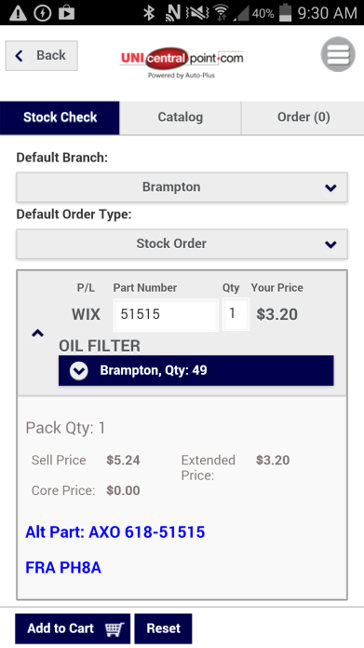
The same experience on Smartphones and tablets
Compatible with any device
A lot of possibilities directly on your Smartphone :
Stock check
Parts Catalog Lookup by VIN/ year / make / model / engine
VINScanner
Place orders

Slide 18
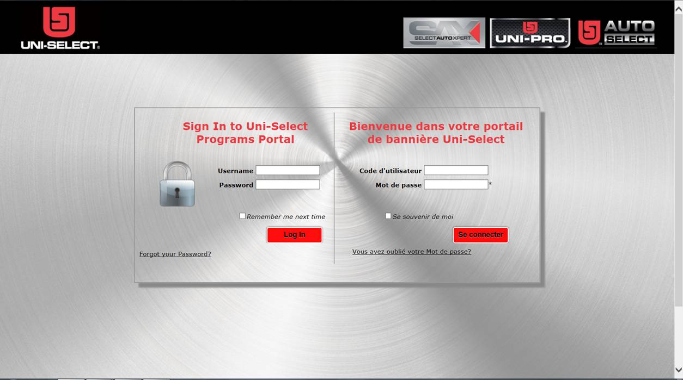
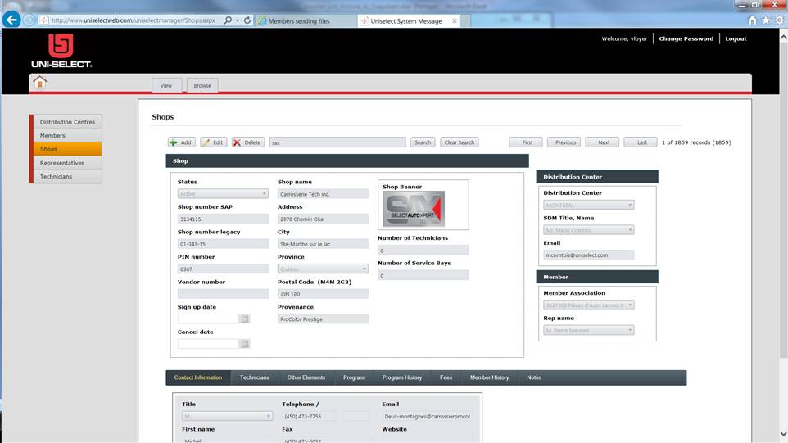
Program Management Portal
View your contact information and all other information about your shop
Update your contact information, such as an address change, email address change, new website, etc.

Slide 19
Services available:
Direct-Hit*
A database for vehicle symptoms, available online
Access to repair tests and fixes generated from over 3.2 million hotline calls
Repair Hotline
A pay-per-use technical assistance call centre
Dedicated to helping technicians in North America solve the toughest diagnostic challenges
Notes:
prix

Slide 20
Offered “à la carte”
Also available in the Custom Packages
Technical information through electronic guides
Mitchell (ProDemand) is offered à la carte and is also available in the Custom Packages option.

Slide 21
All Data
Option - $135-185 / month
Available online 24/7 and automatically updated, our huge database offers you information covering more than 33,000 engine-specific vehicles. Repair procedures, diagrams and TSBs are specific to each vehicle for fast, factory-correct repairs. Your customers will appreciate knowing that your repairs meet manufacturer standards.
Repair Product Only | $135 per month
Repair Product and Tech Assistance | $160
Repair Product and Mobile Application | $160
Repair Product + Tech Assistance + Mobile application | $185

Slide 22
Shop Management System
Manage your shop more efficiently and effectively with ExpressWay SMS provided by Carrus
Option - $159.20/month
Also available in the Custom Packages
Main functionalities
A simple billing system with built-in call back
Optimized client relations management
Easy tracking of repair history, for improved follow-up and service
Complete suite of accounting features
Tire storage management tool
No-hassle data exchange with web catalogues from different partners
A fully bilingual system that is easy to use
A turnkey, all-in-one solution

Slide 23
Preventive maintenance

Slide 24
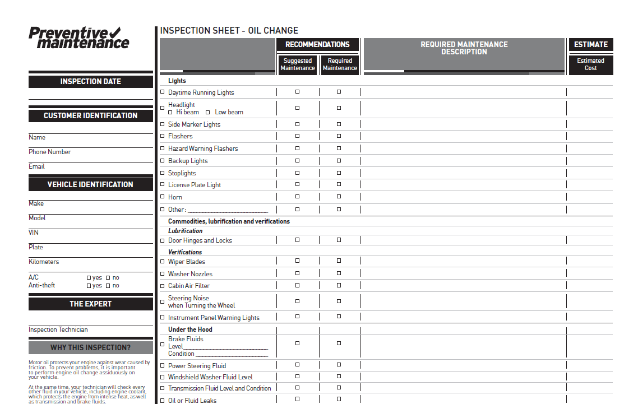
Preventive maintenance inspection sheets
Free system-specific inspection sheets!

Slide 25
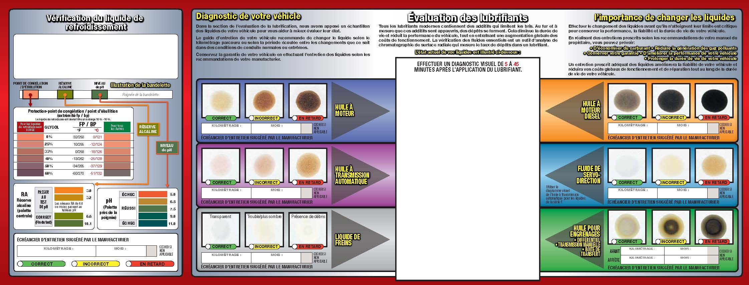
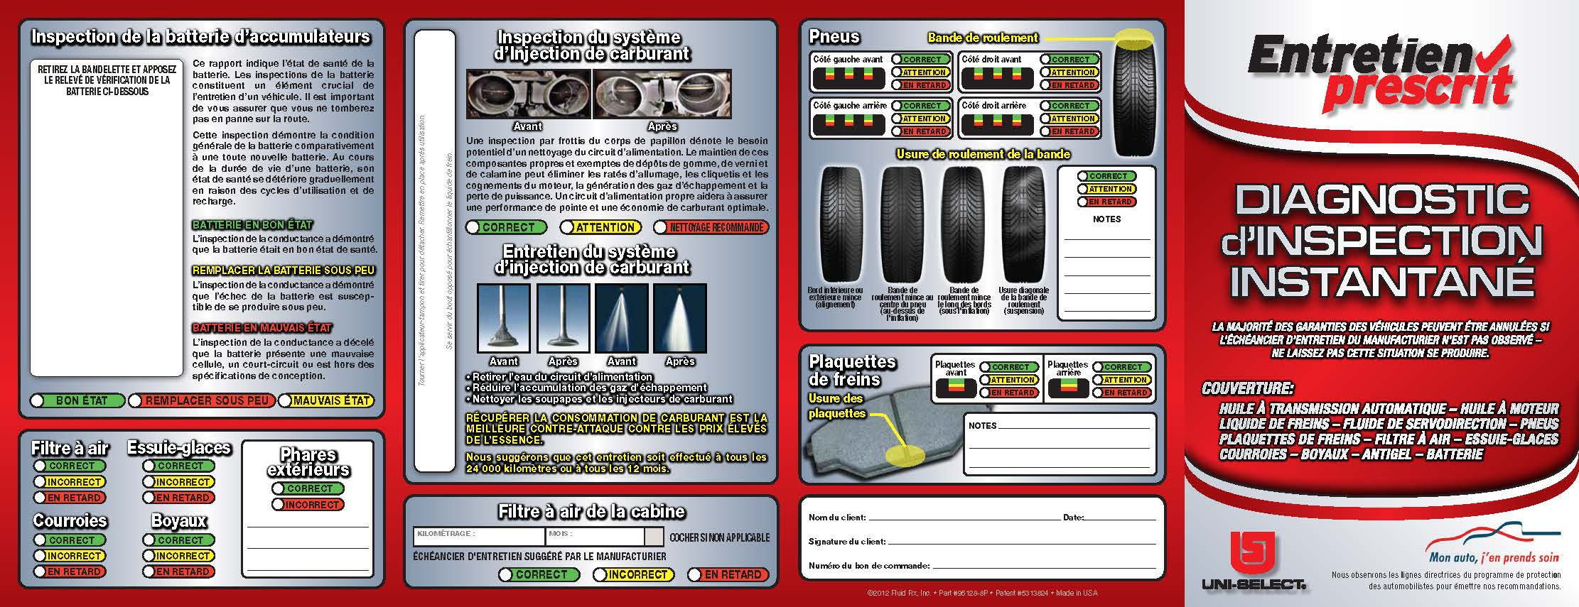
Instant Inspection Diagnostic Flyers
Follows the vehicle’s maintenance schedule to avoid voiding the warranty.
It features a comprehensive evaluation of the vehicle and covers automatic transmission fluid, engine oil, brake fluid, power steering fluid, tires, brake pads, air filter, wipers, belts, hoses, antifreeze and battery.
Available through Nebs for $3.29/flyer.

Slide 26
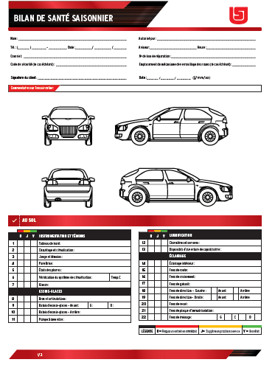
INSPECTION TABLET APP
Application to conduct inspections on vehicle
Custom made by Uni-Select
Available on iStore (iPad) and Play Store (Android tablets)
ONLY 5$ / month!

Slide 27
Training

Slide 28
Training
Hands-on
Offered à la carte, now available in Ontario and Maritimes.
Additional pay-as-you-go management and technical courses available
Online Training
Optional, choose the plan that fits your needs
accessible at all times (24/7)
 | Basic Plan | Medium Plan | Premium Plan
 | $49.95 | $99.95 | $149.95
400 online Courses |  |  | 
120 min. Tech-Line (per month) |  |  | 
Blog on fixes |  |  | 
Employee Evaluation |  |  | 
Also take advantage of:
Extensive tech tips
AutoIQ
ASE FastPase® test prep modules
Notes:
Adapter pour le ROC

Slide 29
Professionnal Development Webcast
A la carte
3-4 webcast / year
Topics and registration links will be sent in advance
Improve your knowledge on various topics

Slide 30
Image and Marketing

Slide 31
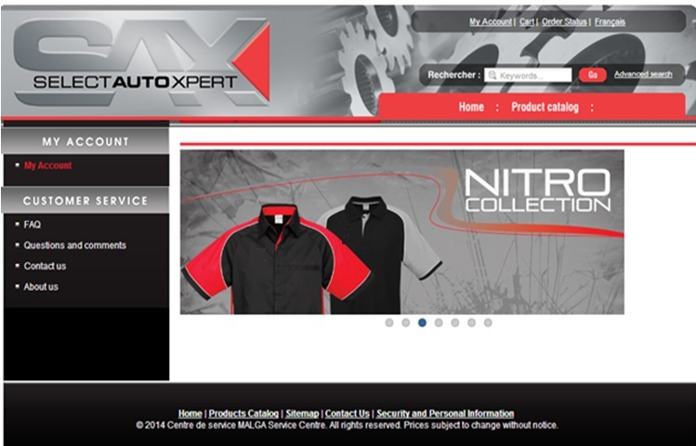
Promotional Items
You can order your promotional items online at
www.magasinuniselect.ca

Slide 32
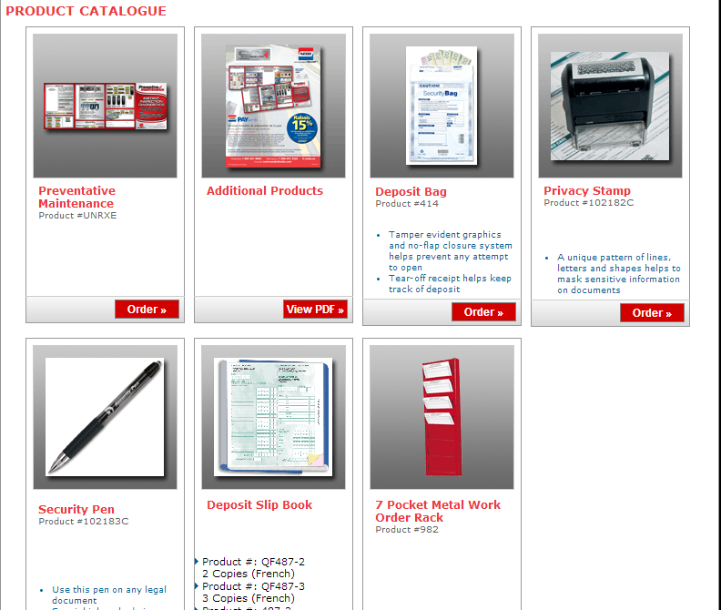
Stationery
Order your items online on Nebs’s order site at http://www.printloft.com/sax

Slide 33
Digital Signage for the Waiting Room
Option - $75 per month*
Digital signage system
Community content exchange option
Dynamic promotional tool
Builds your service advisor’s sales reflexes
Includes corporate content:
Preventive maintenance
Tips and information for consumers
Suppliers’ information and promotions
Local Content
* Additional ScreenScape connect device at $200 USD, invoiced directly by Screenscape
View a demo at
http://screenscape.com/

Slide 34
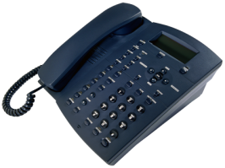
On-Hold Messages
Option - $39.95 per month
Customized message for your shop!
Messages adapted to your program that your callers hear while on hold.
These messages show how professional you are and reinforce your affiliation to the network.
* Additional setup fee of $195 , invoiced directly by PJJ.

Slide 35
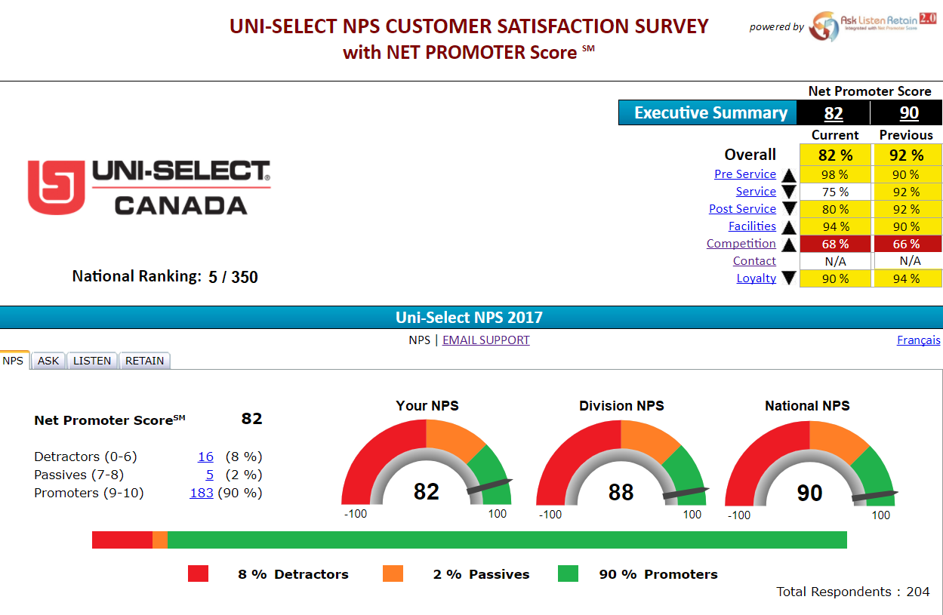
CUSTOMER EXPERIENCE EVALUATION “Ask, Listen, Retain”
$40/month
Subscribe to ASP Service Center

Slide 36
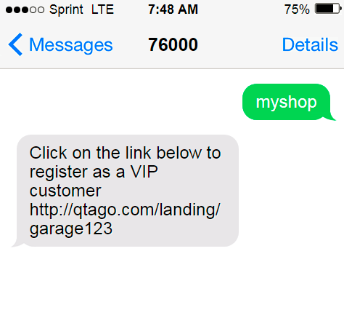
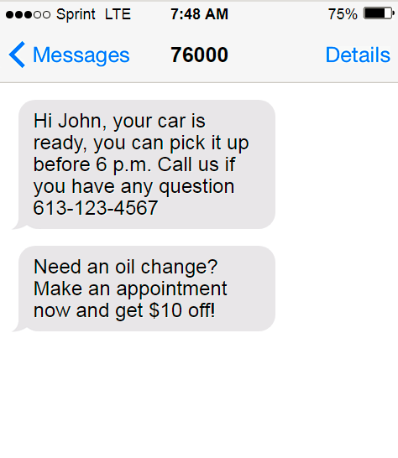
Text Messaging System for Shops (Guazal)
A la carte – 99$/month (36 months contract)
Communicate with your customer efficiently!
Send reminders, promotion, special invitation…etc!

Slide 37
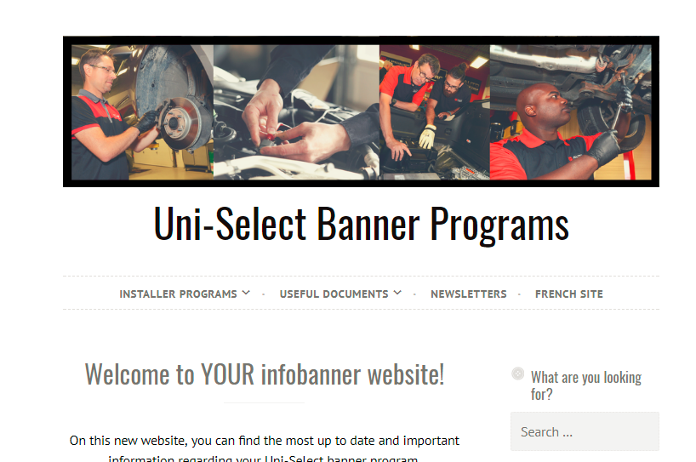
Intranet – myinfobanner.com
Protected website
Latest news and memo are posted on the site
All the program details are available
Downloadable procedures and other important document

Slide 38
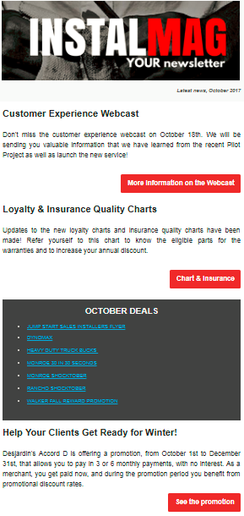
Newsletter Emailed to Shops
Receive your newsletter in your inbox on a regular basis.
It contains tons of info to help you develop your business!
Contact the ASP Service Centre to sign up

Slide 39
Additional Advantages

Slide 40
Corporate Insurance Agreements
Commercial insurance protection:
Your building(s)
Your merchandise
Your equipment
Your customers’ goods
Vandalism
Your business revenue
Cash robbery
Group insurance protection:
Medical care
Life insurance
Long-and short-term disability
Dental care
Offer a little something “extra” to your employees
Personal insurance for you and your employees

Slide 41
Pay Management Services (PayWeb)
Manage your payroll and take advantage of an efficient pay management system at a low cost to reduce your management expenses!

Slide 42
Environmental Agreements
Proud partner of:
Safety Kleen (used oil)
Used oil and cooling fluids collection program

Slide 43
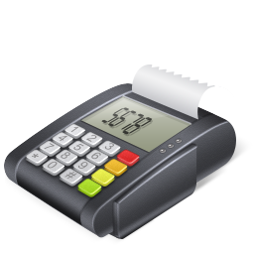
Preferential Rates on Credit Card Transactions
Benefit from a negotiated preferential rate on all transactions made in your shop.
Credit card transaction rate starting at a base rate of 1.52%*
*Rates subject to change without notice.

Slide 44
FAIRSTONE
A private label credit card that works for you
No hardware requirements
No monthly program fees
Low program costs
Deferred payment plans
Quick and easy application
Coast-to-coast service
As of April 1, 2017, CitiFinancial Canada, Inc. will be renamed to Fairstone Financial Inc. and the Retail Services division will now be called Fairstone Sales Solutions.

Slide 45
Monetico Desjardins Payment solution and Point-of-sale
Attract new customer and boost your average bill!
No opening fees
No set up fees
Many plans are offered with discount rates as low as 1.5%.
NEW FOR 2016: Promotional financing plans will be offered for the winter tire period.
Lower rate on debit and credit cards available as of May 1, 2016

Slide 46
Desjardins Accord D
No more in-house financing and high accounts receivable!
Quick approval of customer financing applications
Payment received within two working days
No registration fee
Three payment options:
Deferred payment plan with no customer interest fee
Equal payment plan with no customer interest fee
Equal payment plan with customer interest fee
Increase your customer invoice amounts
Great popularity of Visa Desjardins credit cards
* To take advantage of this service, you must have a Desjardins electronic terminal and your customer must possess a Visa Desjardins credit card.

Slide 47
Auto-Jobs.ca
A free specialized automotive staffing website with an online job
posting service.
The agreement between Uni-Select and Auto-Jobs.ca allows you to take
advantage of a 10% rebate on job postings on this site.

Slide 48
AIR MILES
Ask for your AIR MILES Reward Miles on purchases made through your participating Uni-Select Merchant Member.*
1 Reward Mile per $30 in purchases
Choose from more than 1,000 rewards available!
* Available at your Auto-Plus and Auto Parts Plus participating stores.

Slide 49
Overview of the SAX program
Included
Choice of monthly options
Pay-as-you go
Loyalty Rebates
Labour Warranty on Standard Vehicles - (90 days)
ASP Central Point
Preventive maintenance inspection sheets
Program Management Web Portal
Program related information Website
ExpressWay (SMS) $159.20
TechPro Online
Basic Plan $49.95
Medium Plan $99.95
Premium Plan $149.95
Digital signage $75.00
On-hold messages $39.95
Identifix
Mitchell (ProDemand)
Technical training and management courses
Promotional Items, Uniforms
Stationery
Instant Inspection Diagnostics Flyers (IID)
Preferential rates on credit card transactions
Pay management services
Other additional advantages

Slide 50
We look forward to having you among us!

